Slide 1


Analyzing CS:GO Player Performance
A data-driven approach to understand player metrics in CS:GO
by Arya Belhe

Slide 2
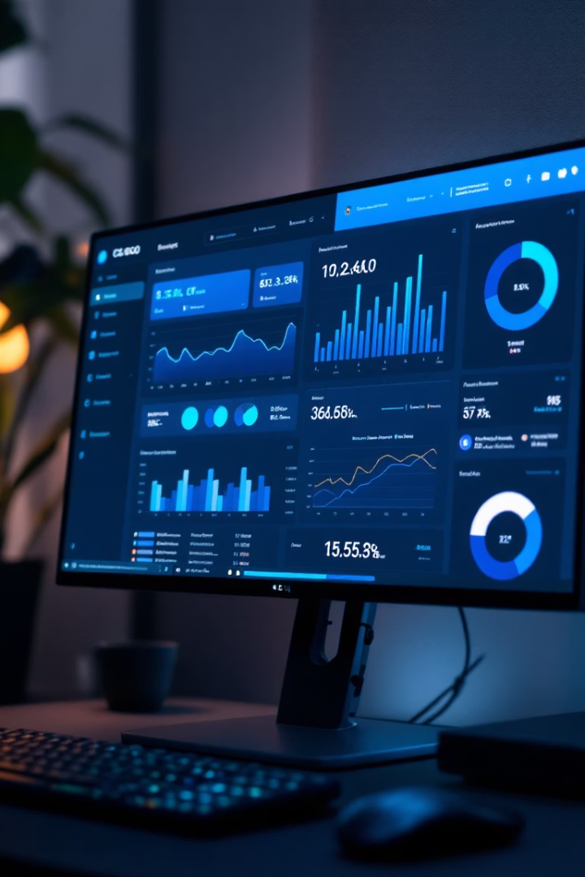
Methodology & Tools
Data Handling
Libraries
CSV dataset cleaned and preprocessed
pandas, matplotlib/seaborn, scikit-learn
Feature Engineering
K/D difference, kills per round, headshot ratio, Damage per round.

Slide 3
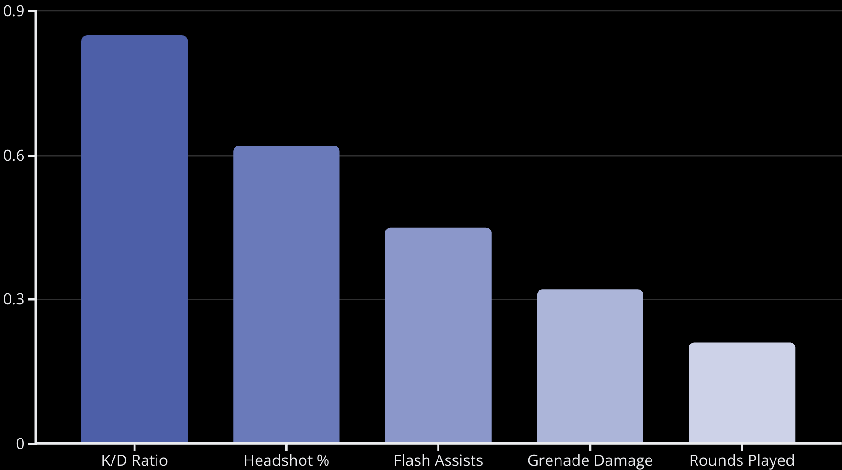
Exploratory Data Analysis

Slide 4




Real-Life Applications
Esports Scouting
Identify rising talent
Teams can use predictive metrics (K/D ratio, headshot %, etc.) to identify emerging talent
Objective data reduces bias in player evaluation
Supports data-driven scouting decisions
Player Training
Focus on high-impact stats Personalized coaching plans based on performance gaps
Focus on improving precision (headshot %) and survivability (K/D difference)
Track training impact using measurable metrics over time
Analytics Dashboards
Real-time tracking for coaches Build live dashboards to monitor player stats during or after matches
Help coaches adapt strategies in real-time
Identify underperforming roles or map-specific weaknesses
Gamer Tools
Performance feedback apps Create feedback systems (web or in-game overlays) for individual players
Use ML-driven insights to suggest areas for improvement
Promote self-coaching and competitive growth among casual and semi-pro players

Slide 5





Modeling & Code Overview
Data Ingestion
Tool:- Pandas.read_csv()
Purpose:- Load data from CSV files into a Dataframe.
Data Preprocessing
Steps:- Handling missing values, data formating,
Visualization
Seaborn plots
ML Models
Linear Regression

